Slide 1
Security Verification Using the
Chisel Hardware Construction Language
Corine Lu
Jakub Szefer
Computer Architecture and Security Lab
Yale University
14 July 2017
Notes:
Hardware security verification is the act of proving the security of a hardware system during its design phases
In order to do this, Chisel creates a software design abstraction to test for vulnerbilities
What is security verification?
No name and lab
What kind of hardware? communication
Who would be thinking of this
Software simulation of hardware

Slide 2
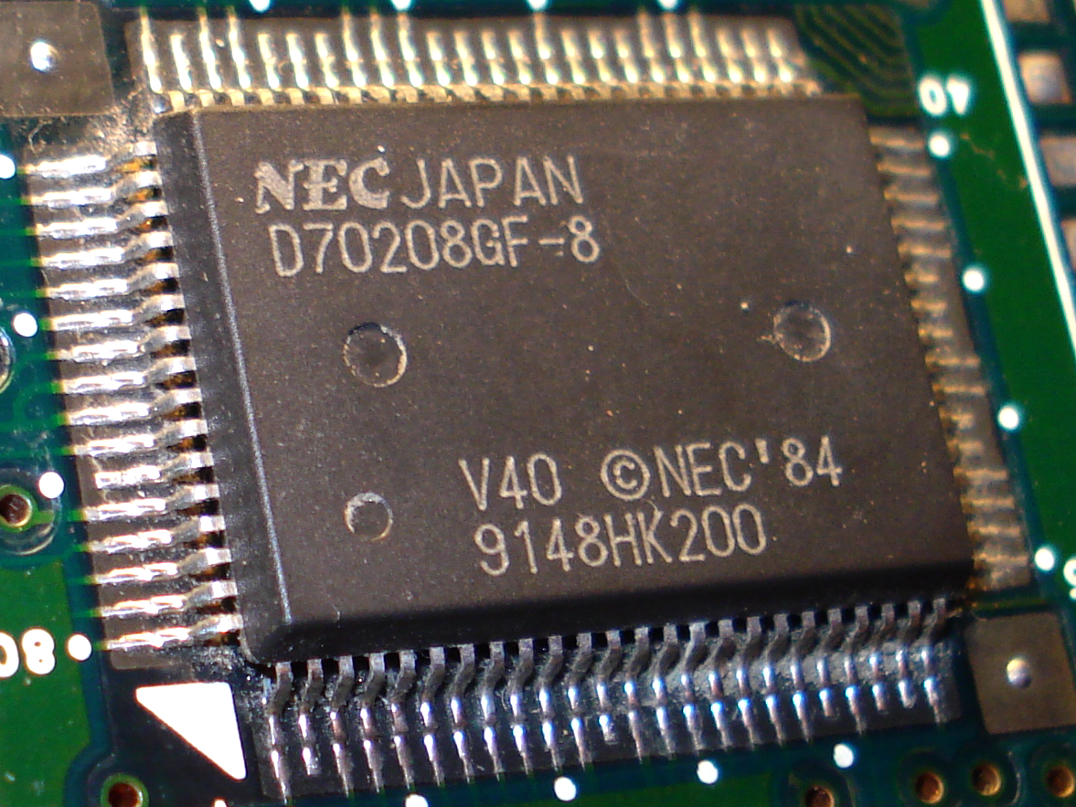
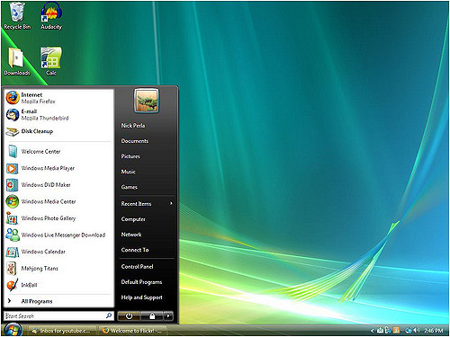
Computer Architecture
Microprocessor
Stores and accesses data
Acts as central processing unit
Hardware
Operating System
User interface
Allows interaction with microprocessor
Software
Notes:
In computer architecture, there is a microprocessor which stores and accesses data and acts as the central processing unit to carry out commands given by teh operating system or the user interface of the computer
Hardware security verification could be used in this case to assess the design of the microprocessor and test its security capabilities during its design stage, before mass production. This is extrememly valuable because security vulnerabilities are incredibly difficult, if not impossible, to patch after manufacturing.
Center subtitles, more descriptive
Onboard communication or network?
Consider this, test it then can produce in mass
Need to communicate to other networks
Security is a big challenge

Slide 3
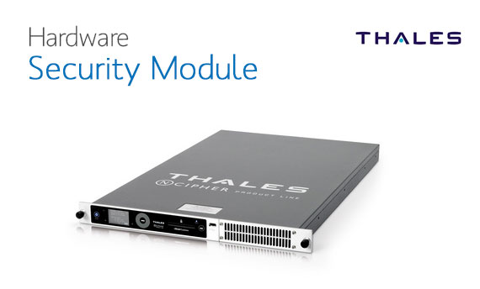
Hardware Security Issues
Scan and monitor network traffic
Cryptographic keys
Especially important in critical infrastructures
Essential for software as the lowest level of security
Notes:
Since hardware is used in a variety of highly sensitive areas, it is important to strive for the least security vulnerabilities possible.
For example, hardware is used to scan and monitor network traffic. Hardware firewalls prevent unauthorized users from accessing sensitive data within a network.
Hardware is also used to generate cryptographic keys for encrypting and decrypting data. If the technology used in these functions remained faulty, there would be negative reprocussions in critical infrastructures such as a hospital where patient’s medical records are kept.
And even if the software within a computer system were completely free of vulnerabilities, lasting security issues within hardware, the lowest level of security, would still compromise the entire system.
Issues with software, application, OS, compromised
Hardware run with software, need to make sure software is secure, need both
Examples of what I’m trying to improve
Truncate my half
More descriptive title

Slide 4
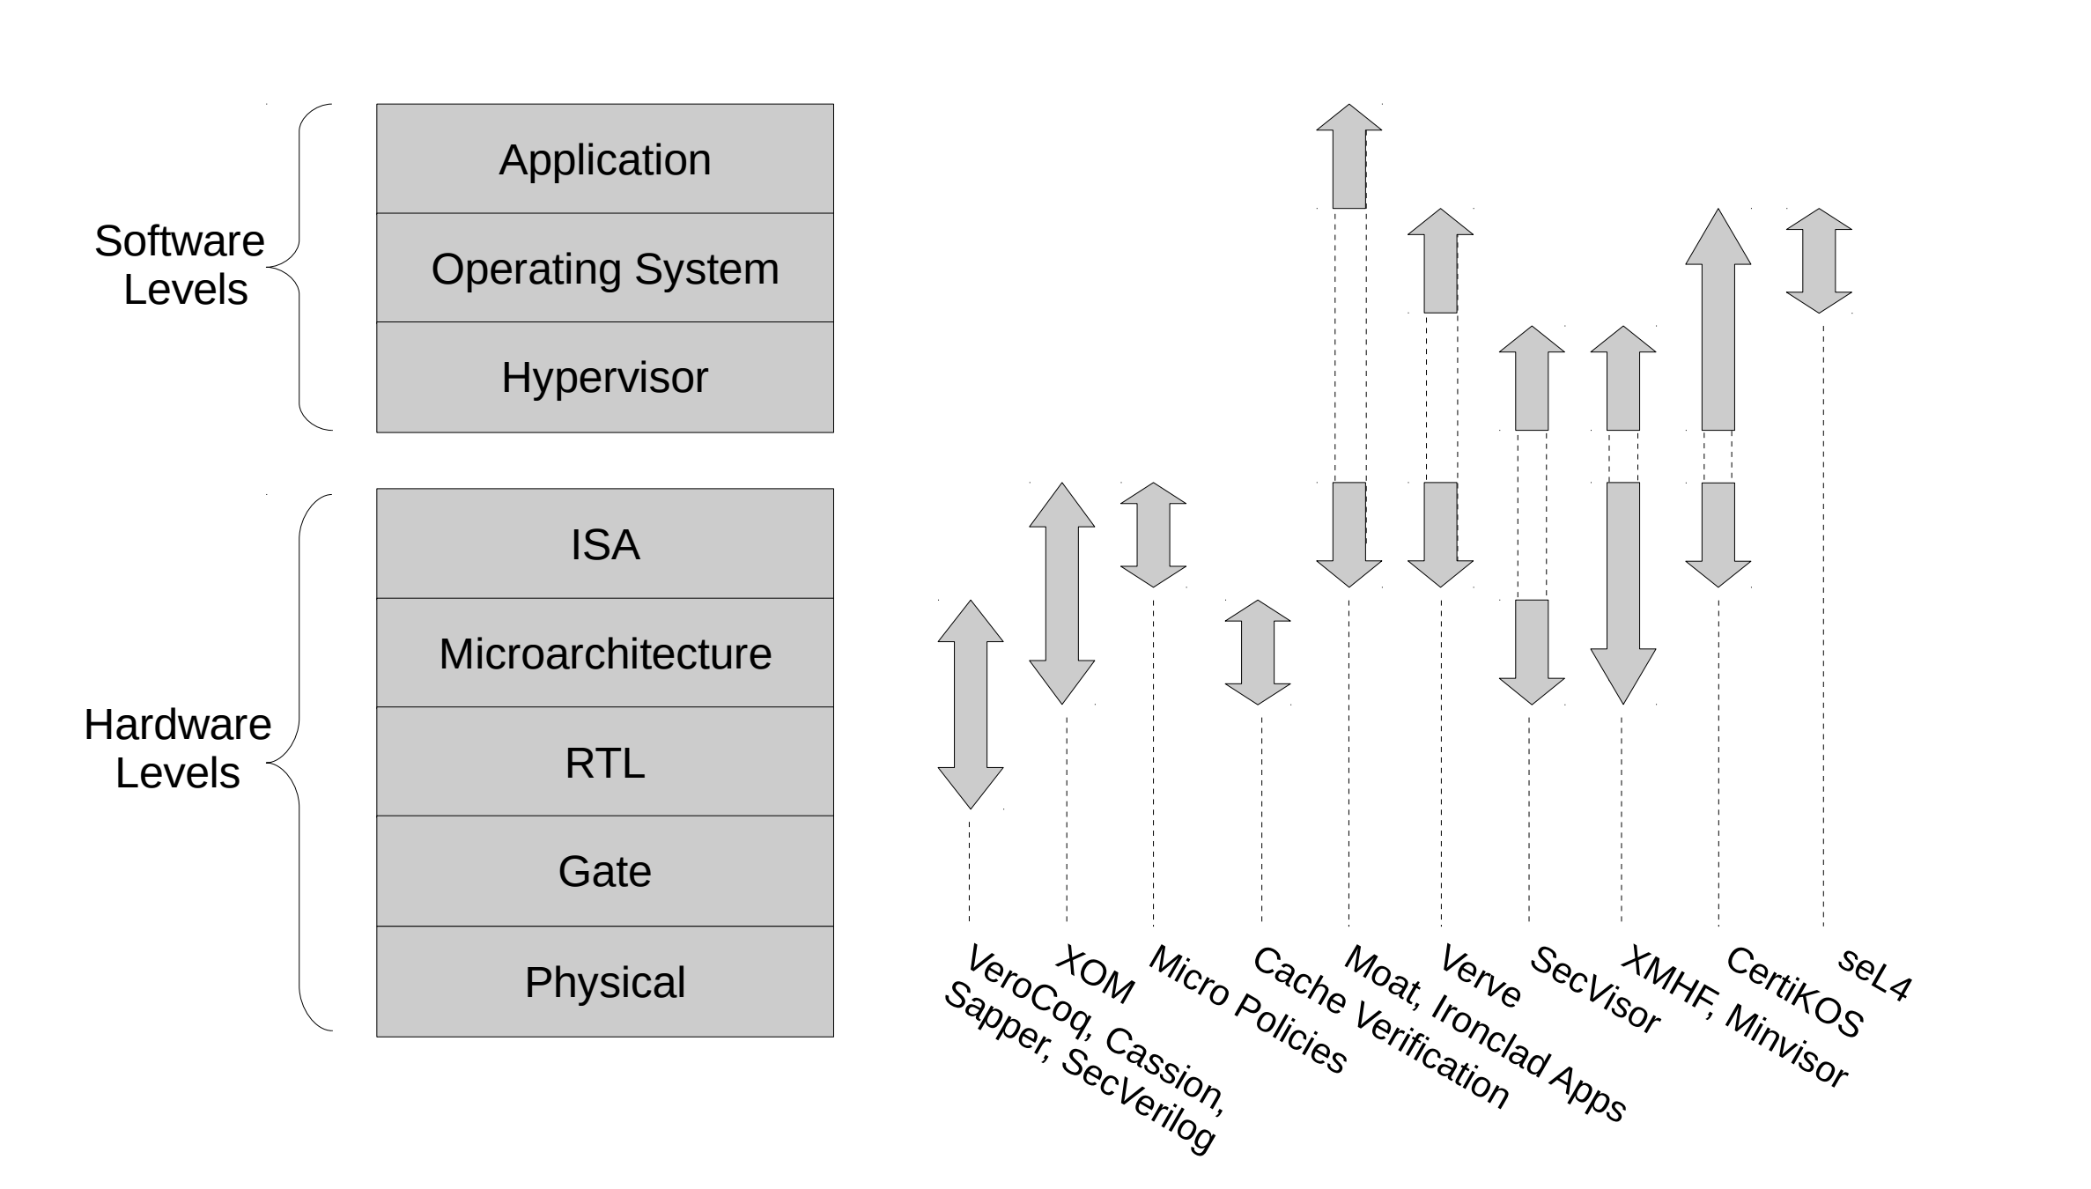
System Verification at Multiple Levels
Notes:
System verification can happen at a variety of levels. It can be done throughout software, hardware, or a mixture of both.
My work focuses specfically in hardware, in microarchitecture and Register transfer levels or RTL. This means we are looking speicifically at the flow of data within the elctriconic components of a computer system. And to do so we are using the hardware description language, Verilog.
Move title up and make picture largerVerification can be done at software, hrdware levels. My work focuses on the microrchirect, Register or RTL. This range, red box , is verified with software A, B,C. C is used in this work.

Slide 5
Security Verification Approach
Chisel Hardware Construction Language
Software supporting hardware design
Creates abstractions and is highly parameterizable
Modifying Chisel => SecChisel with security tagging
Looking at information flow
Notes:
In order to make Verilog more developer friendly, our lab is using the Chisel hardware construction language developed to make low-level Verilog code
Chisel creates design abstactions and is highly parameterizable, meaning it can be defined by a set of rules
By modifying Chisel into secChisel, security tagging of the data flow is possible.
After this single-file code is developed, it can be run through verification where it will be testedd to see if data from high security channels are leaking into channels of low security.
One approach is info flow
Used to check if sensitive info is leaking
Improve functionality - move it to the first bullet
Truncate the language one
Just chisel and talk about objective

Slide 6
Hardware Security Verification
Security Properties
System Representation
Formal
Verification
Notes:
Security Properties are appropriate standards to meet to be considered secure. THis can vary from team to team.
System Representation accurately represents the behavior of the system using SecChisel
Formal Verification is proving or disproving whether the system meets the security properties
First define security properties
Then you need system representation the simulation of hardware, SecChisel

Slide 7
Formal Verification using SMT Solvers
Run it through SMT (Satisfiability Modulo Theory) Solver
Takes assertions (security properties) and rules (system representation)
Satisfied vs. Unsatisfied
Proving or disproving statements in SecChisel
Must convert SecChisel code
Issues with speed
Notes:
Formal verificatio nis performed with SMT Solvers or or sat modulo theory solvers which take assertions and rules
Tell you if satisfied or not.
In order to so, you must convert the file generated by SecChisel into a file compatible wit hteh SMT Solver and run it
However you encounter issues with speed once design become very large and when designers make many small tweaks with their designs and wish to test them.
Condense with previous slide
Reorder - SMT solver
Must convert code, rewirte to get rid of bullets, what do smt solvers do what did it need compatibility issues
Speed =?
Emphasize the smt code must be converted

Slide 8
Optimizing Formal Verification
SMT Code:
Using less expensive functions and procedures that take less time to run
Ignore some instructions and/or merge
SMT Solver:
Z3 is currently most popular
Looking for other solvers that better fit the needs of SecChisel
Program Execution:
Sequential processing vs. parallel processing
Notes:
My objective is optimizing formal verification and improving its run time.
One method is by altering the code going into the SMT solver. This includes using less expensive functions which means using procedures that take less time to run
We can also ignore some repetitive instructions or merge similar ones to cut down the number of rules to check against.
ANother method is choosing the most efficient SMT solver. There are a variety of solvers out there adn we currently use the Z3 solver because it is the most popular rather than the one most tailored to the needs of SecChisel.
Looking for solvers that better firt the needs of SecCHisel would improve the performance of formal verification.
The third method we are exploring is changing program execution.
Cut down words
Last two bullets for code are cryptic
File representing security parameters and design

Slide 9
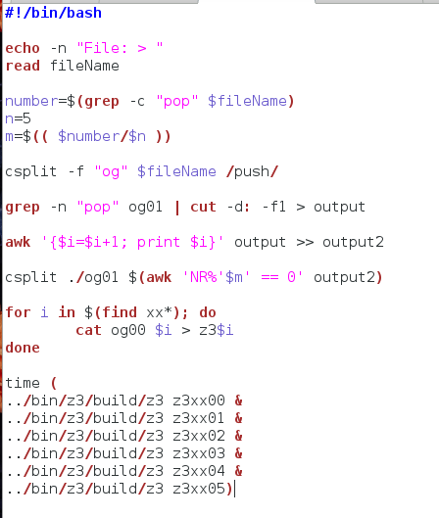
Script Algorithm to Split Z3 File
SMT Code File
Notes:
In order to run the code in parallel, I needed to first break the file in several pieces. To do so I used a script or a series of commands to do so and wrote an algorithm.
I began with the single smt code file.
Not clear it is methodology, make it more clear
Use picture
Either talk about the code of get rid of picture

Slide 10
Script Algorithm to Split Z3 File
SMT Code File
Assumptions
Rules
Notes:
I proceeded to break the file into a list of assumptions and a list of rules
Not clear it is methodology, make it more clear
Use picture

Slide 11
Script Algorithm to Split Z3 File
SMT Code File
Assumptions
Rules
File 1
File 2
File 3
File 4
File 5
Notes:
I then break up those rule evenly into any desired interval I choose, in this case I wanted 5 files.
Not clear it is methodology, make it more clear
Use picture

Slide 12
Script Algorithm to Split Z3 File
SMT Code File
Assumptions
Rules
File 1
File 2
File 3
File 4
File 5
Notes:
Since every smt file neeeds to same assumptions or security parameters, I appended the assumptions to each file. And the result is 5 files that run exactly the same but have less rules in each. I then run these files in the z3 solver and begin analyzing the time it takes to do so.
Not clear it is methodology, make it more clear
Use picture

Slide 13
Average Time to Execute SMT Files
Rules | 1 file (ms) | 5 files (ms) | 10 files (ms)
119 | 43.8 | 17.2 | 23.2
29 | 38.0 | 22.7 | 23.0
Notes:
This is result
Able to get time to decrease using the methods
Should be a summary slide
Darker green
Another slide to discuss
More cores with servers
29 less complicated 119 more complicate
Files given to me

Slide 14
Average Time to Execute SMT Files
Rules | 1 file (ms) | 5 files (ms) | 10 files (ms)
119 | 43.8 | 17.2 | 23.2
29 | 38.0 | 22.7 | 23.0
-26.6
-20.6
-15.3
-15.0
Notes:
This is result
Able to get time to decrease using the methods
Should be a summary slide
Darker green
Another slide to discuss
More cores with servers
29 less complicated 119 more complicate
Files given to me

Slide 15
Average Time to Execute SMT Files
Rules | 1 file (ms) | 5 files (ms) | 10 files (ms)
119 | 43.8 | 17.2 | 23.2
29 | 38.0 | 22.7 | 23.0
Clear decrease in time with parallelization
System setup time
Dependent on number CPU cores
-26.6
-20.6
-15.3
-15.0
Notes:
This is result
Able to get time to decrease using the methods
Should be a summary slide
Darker green
Another slide to discuss
More cores with servers
29 less complicated 119 more complicate
Files given to me
Add computer used
Add limitations, separate conclusions and future directions

Slide 16
Future Directions of Formal Verification
Parallelization improves the runtime of formal verification
Test with more intervals and rules
Run on servers with more processor cores
Work on other methods of optimizing
Notes:
Concluson anf future work
How many cores on processors
See more rules
Future direction, scale it up

Slide 17
Acknowledgements
Thank you to:
STARS Program - Yale College
Professor Moreno
Professor Nelson
Professor Purushothaman
Robert Fernandez
Computer Architecture and Security Lab
Jakub Szefer
Shuwen Deng

